Slide 1

Presentation on SMART CONTACT MANAGER
SUBMITTED BY
UDHAYANITHI T
VIJAYALAKSHMI D
NAGALAKSHMI M
ARUNKUMAR T
SUBRAMANIAN E
Batch: 2021-6260
Center: Chennai-Chromepet
UNDER THE GUIDENCE of
RAHUL GABA
Technical Trainer
Edubridge (Capgemini Certified Java Full Stack Professional)

Slide 2
ABSTRACT
Smart Contact Manager(SCM) is a software program that enables users to easily store and find contact information, such as names, addresses, and telephone numbers. They are contact-centric databases that provide a fully integrated approach to tracking all information and communication activities linked to contacts.

Slide 3
INTRODUCTION
If you have a new member on your staff, it's easy to share all your business contacts. Or if you need to transfer contact data from one account to another, Smart Contact Manager can do it in a single click, synchronizes all data.
Smart Contact Manager provides a wide range of remote development services and has a clear goal to help startups and companies solve various tasks regardless of the level of complexity and scale.
Smart Contact Manager store your contact in modern way.

Slide 4
SYSTEM REQUIREMENTS
Hardware Requirement:-
Software Requirement:
i3 or i5 Processor
4 GB RAM
100 GB Hard Disk
Windows 10 OS
Front End: HTML, CSS, JavaScript
Back End: Spring Boot and JPA Hibernate
DB Server: MySQL Server 8.0.CE
Web Server: Apache Tomcat
IDE: Spring Tool Suite(STS)
Browser: Google Chrome or MS-EDGE

Slide 5
PROJECT MODULES
Home Module
About Module
Signup Module
Login Module

Slide 6
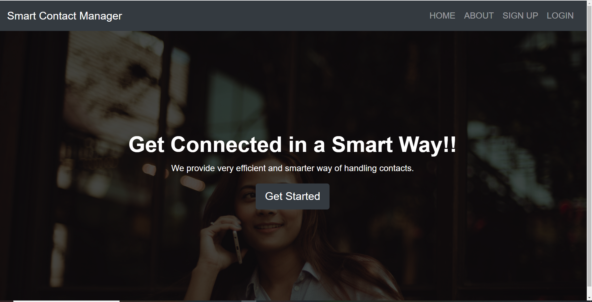
HOME MODULE

Slide 7
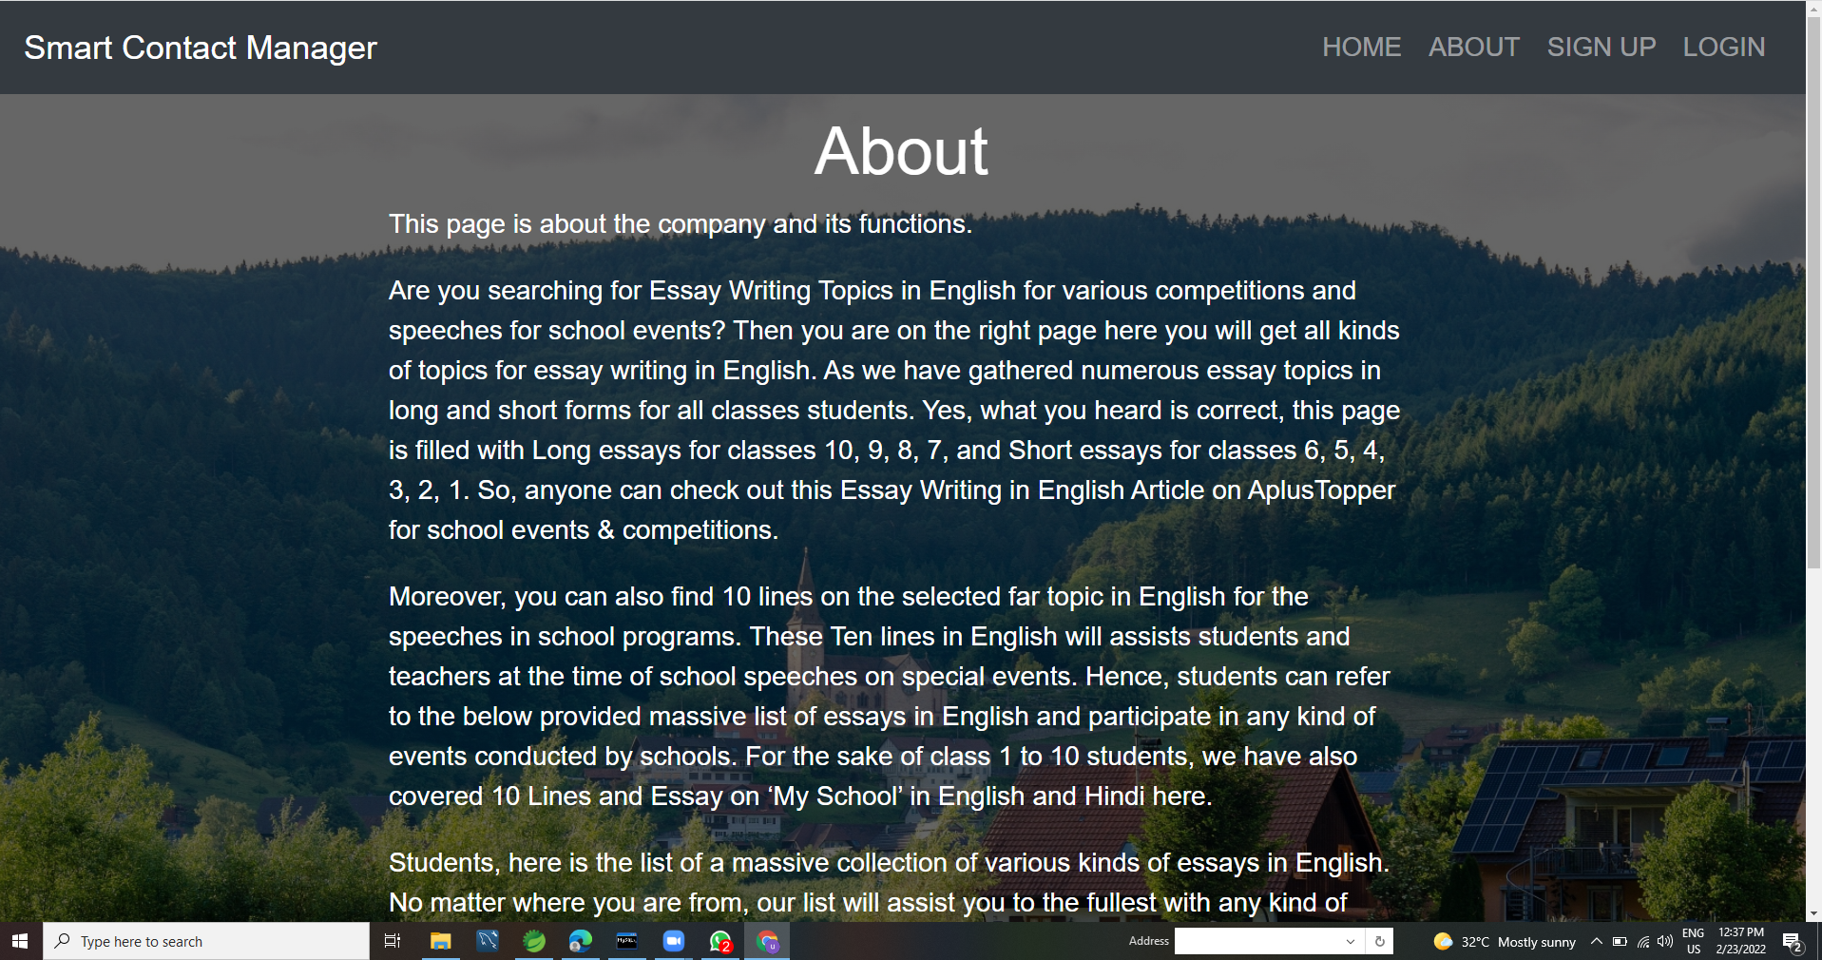
ABOUT MODULE

Slide 8
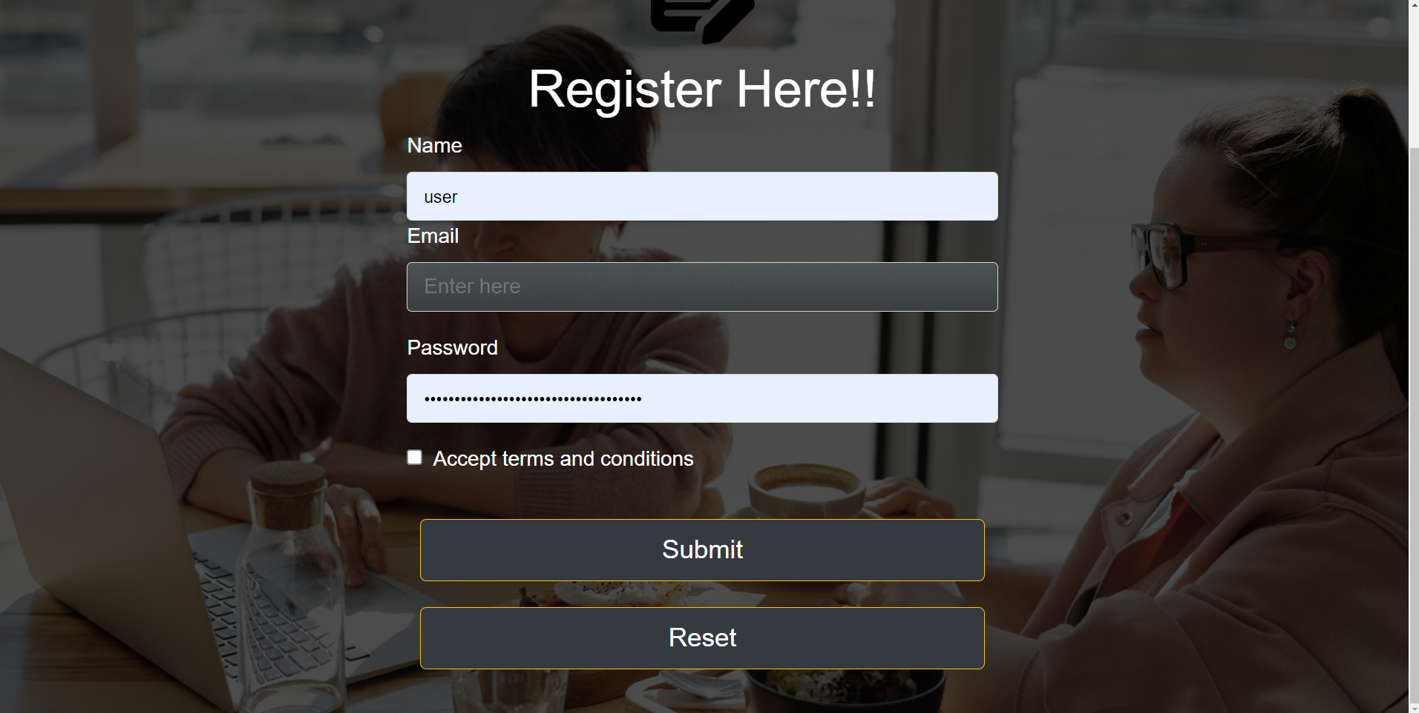
SIGN-UP PAGE

Slide 9
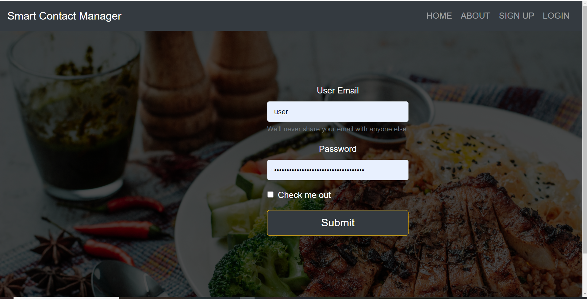
LOGIN MODULE

Slide 10
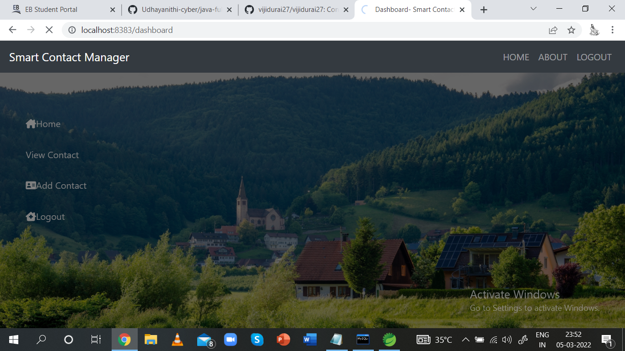
DASHBOARD

Slide 11
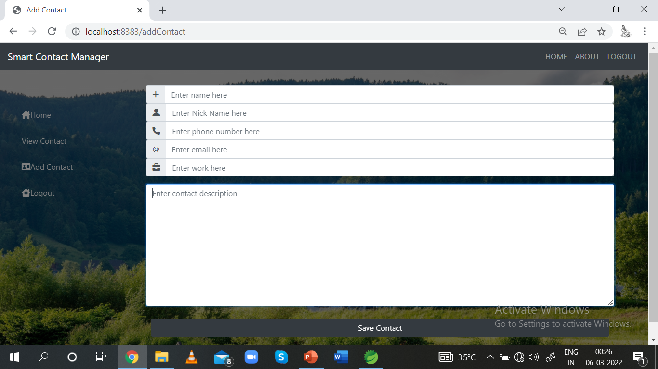
ADDING CONTACT

Slide 12
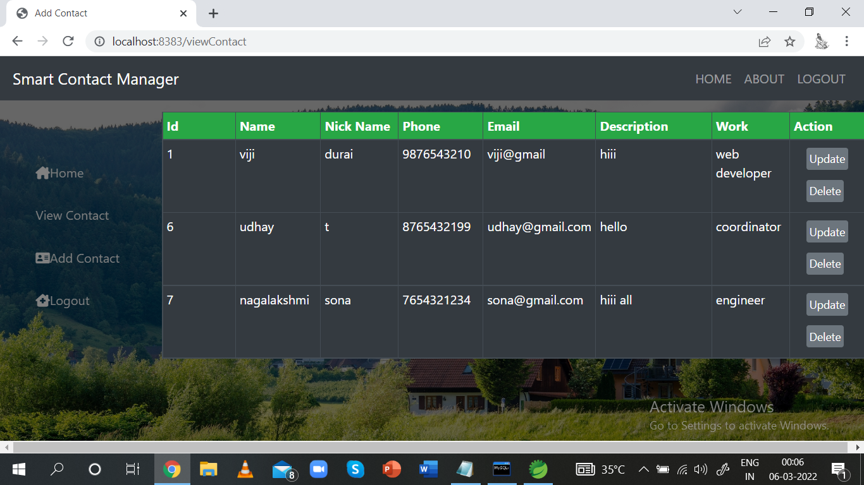
VIEW CONTACT

Slide 13
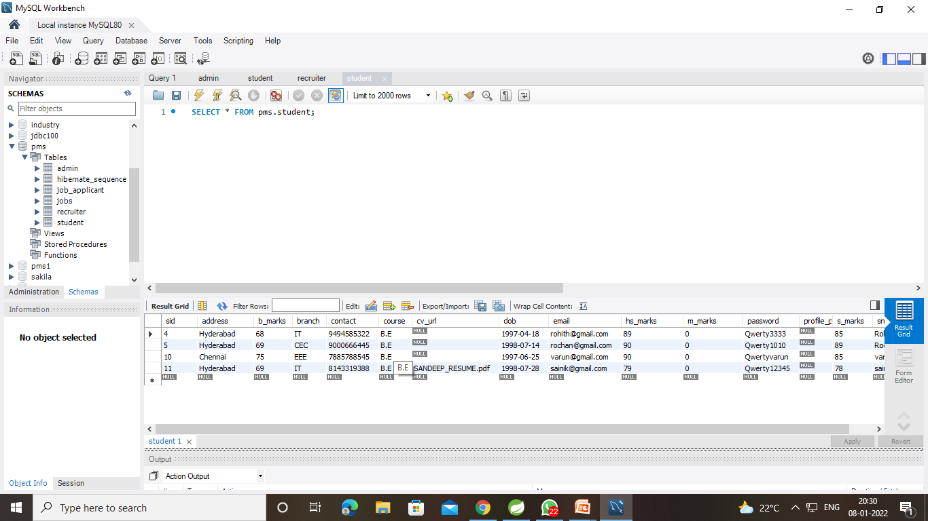
DATA DICTIONARY
USER DATABASE

Slide 14
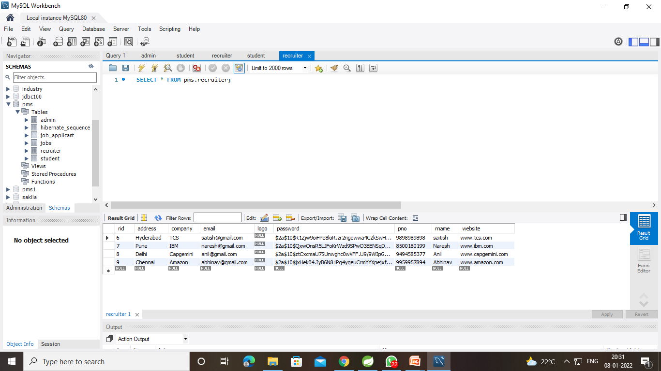
DATA DICTIONARY
USER CONTACT DATABASE

Slide 15
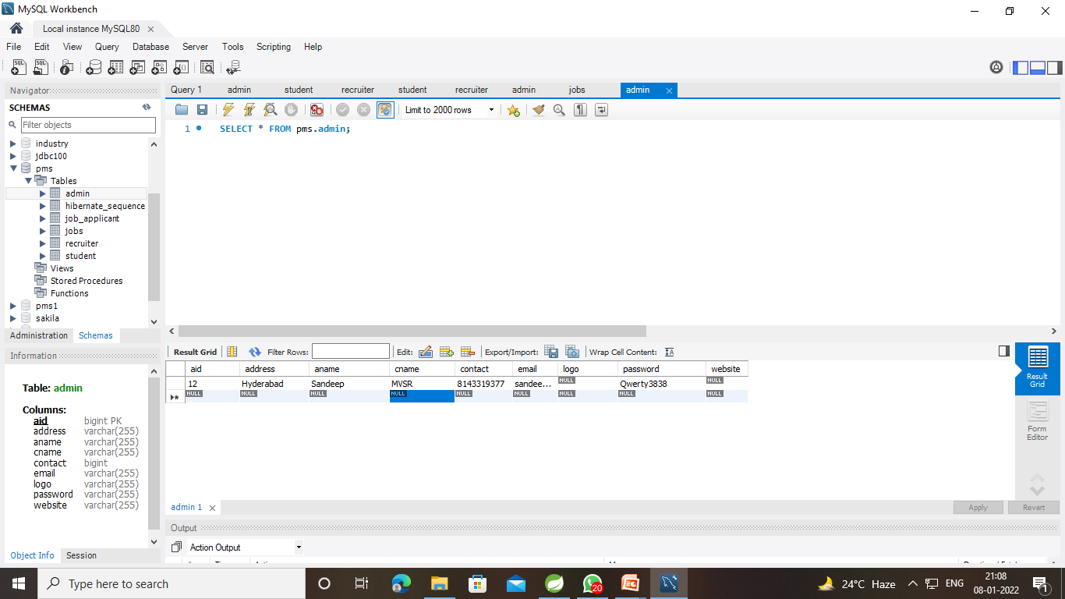
DATA DICTIONARY
CONTACT DATABASE

Slide 16
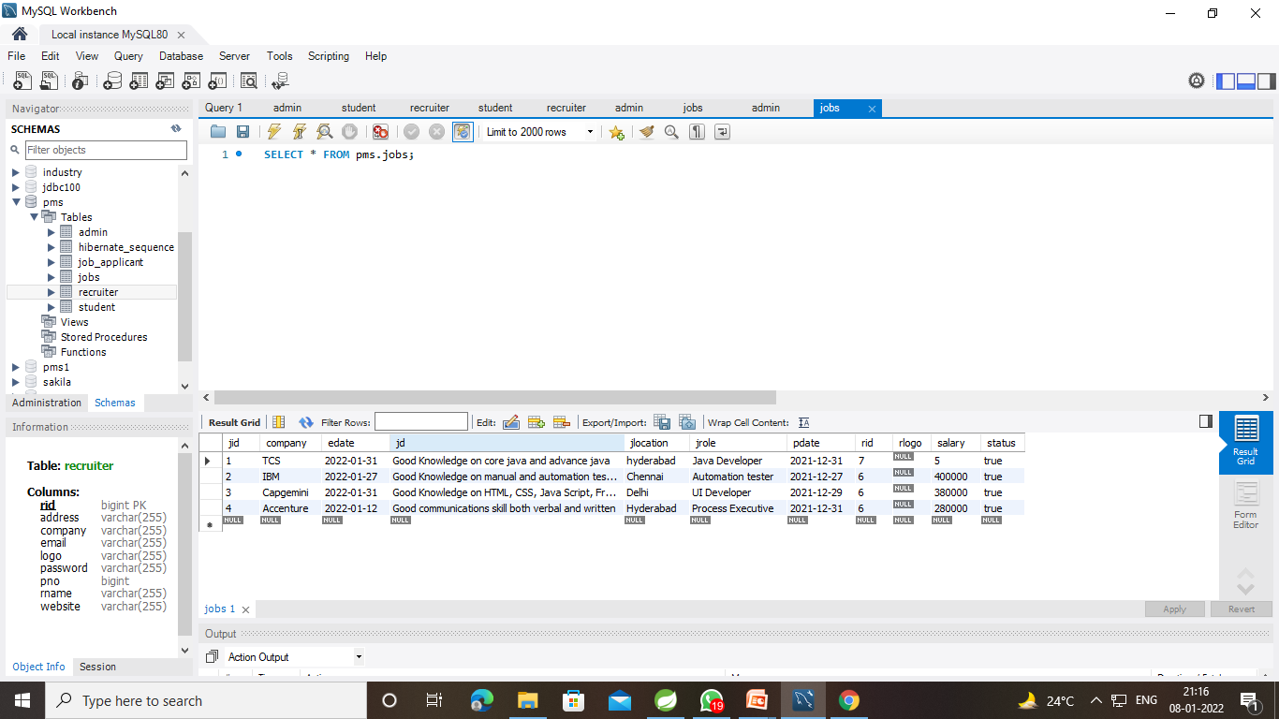
DATA DICTIONARY
HIBERNATE SEQUENCE DATABASE

Slide 17
PROJECT IMPLEMENTATION
Project Implementation Technologies:
The Project is Developed in Spring boot technology. We used Spring Tool Suite IDE for Design and develop project coding part. To store project data I am used MySQL Server 8.0 in that I am create tables or entities, use to data related each module.

Slide 18
conclusion
In this project presentation, we explained the system design, requirements and implementation and the modules we have done till now. In accessing the outcome of this system, we have come to the final conclusion that Smart Contact Manager is more convenient than normal Contact Process or System.

Slide 19
REFERENCES
www.tutorialspoint.com
software engineering (roger s. pressman)
java complete html
www.wikipedia.com

Slide 20
THANK YOU

